Slide 1
IETF125 HP-WAN Hackathon
Champions:
Quan Xiong (ZTE ), Daniel King (Lancaster University),
Kehan Yao (China Mobile), Junfeng Zhao (CAICT)
IETF 125 @ Shenzhen March, 2026

Slide 2
IETF125 HP-WAN Hackathon
Hackathon Goals
HPWAN integration and simulation on topologies for public networks and service scenarios based on the HP-WAN framework and related functions, such as the rate negotiation, admission control, traffic scheduling, and resource reservations with distributed signalling (IETF RSVP-TE)
Implement the system optimizations (e.g., QUIC-based) for the traffic transmission
Test and evaluate the performance (e.g.,throughput, delay, and packet loss) using RDMA, TCP, and UDP over the existing public network
Discuss HPWAN developments in R&E networks and open-source controllers and orchestrators for integrated HPWAN scheduling and connection performance monitoring (IETF RestConf/NetConf/YANG)
Activity plan
Develop initial service model for scheduled HPWAN-based services
Identify service and network performance metrics required to be reported from each HPWAN transport domain
Start-up
Ongoing
Tear-down
Select IETF-based measurement methods and tools for ensure HPWAN service performance is met across each domain

Slide 3
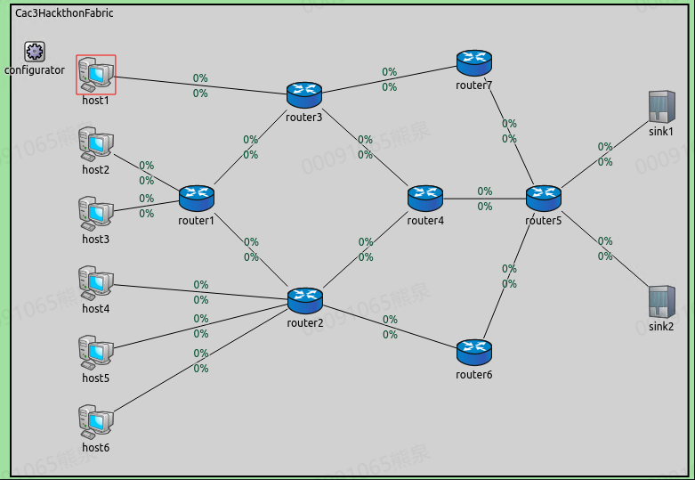
Topology and Scenario for HP-WAN RSVP-TE Simulator
Topology
host 1~6 ( as client) and sink 1~2 (as server)
router 1~7 in WAN (link bandwidth is 40Gpbs
and RTT is 10ms or 15ms (about 1000km/1500km)
Scenario
host 1~4 send a flow to sink1
host 5~6 send a flow to sink2
each flow is 100MB
Simulation Results
FCT of per flow or multiple flows
Effective throughput at the receiving port

Slide 4
IETF125 HP-WAN Hackathon
Related documents
https://datatracker.ietf.org/doc/draft-kcrh-hpwan-state-of-art/
https://datatracker.ietf.org/doc/draft-xhy-hpwan-framework/
https://datatracker.ietf.org/doc/draft-xiong-hpwan-signaling-solution/
https://datatracker.ietf.org/doc/draft-yx-hpwan-uc-requirements-public-operator/
https://datatracker.ietf.org/doc/draft-zhao-hpwan-scenarios-deployment/
Repository:
https://github.com/xiongquan1230/IETF125-HP-WAN-Hackathon
Hackathon Table 23 HP-WAN Project
We greatly appreciate the participants (onsite or remote) to join us! Thanks!

